Slide 1
The Data Link Layer
Chapter 3

Slide 2
Data Link Layer Design Issues
Services Provided to the Network Layer
Framing
Error Control
Flow Control

Slide 3
Functions of the Data Link Layer
Provide service interface to the network layer
Dealing with transmission errors
Regulating data flow
Slow receivers not swamped by fast senders

Slide 4
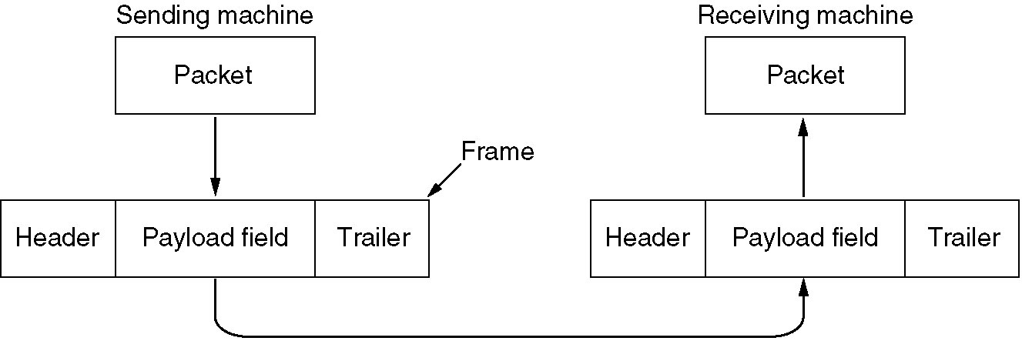
Functions of the Data Link Layer (2)
Relationship between packets and frames.

Slide 5
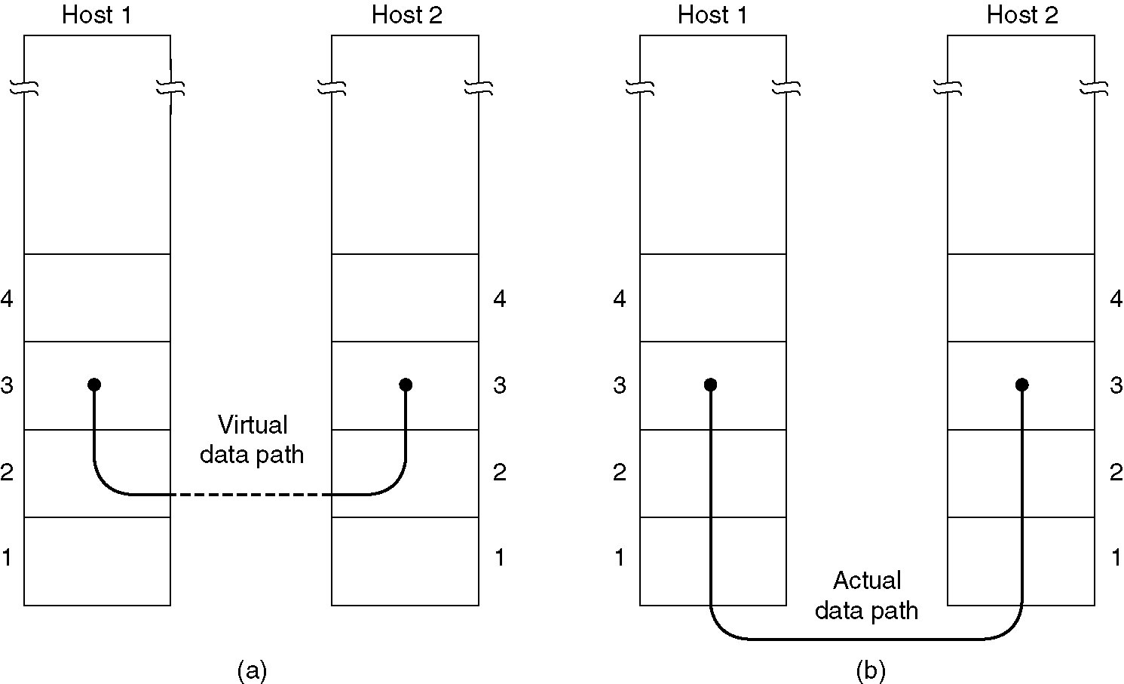
Services Provided to Network Layer
(a) Virtual communication.
(b) Actual communication.

Slide 6
Services Provided to Network Layer (2)
Data link layer can provide three types of services to the internet layer
Unacknowledged connection less
Acknowledged connection oriented
Acknowledged connection less

Slide 7
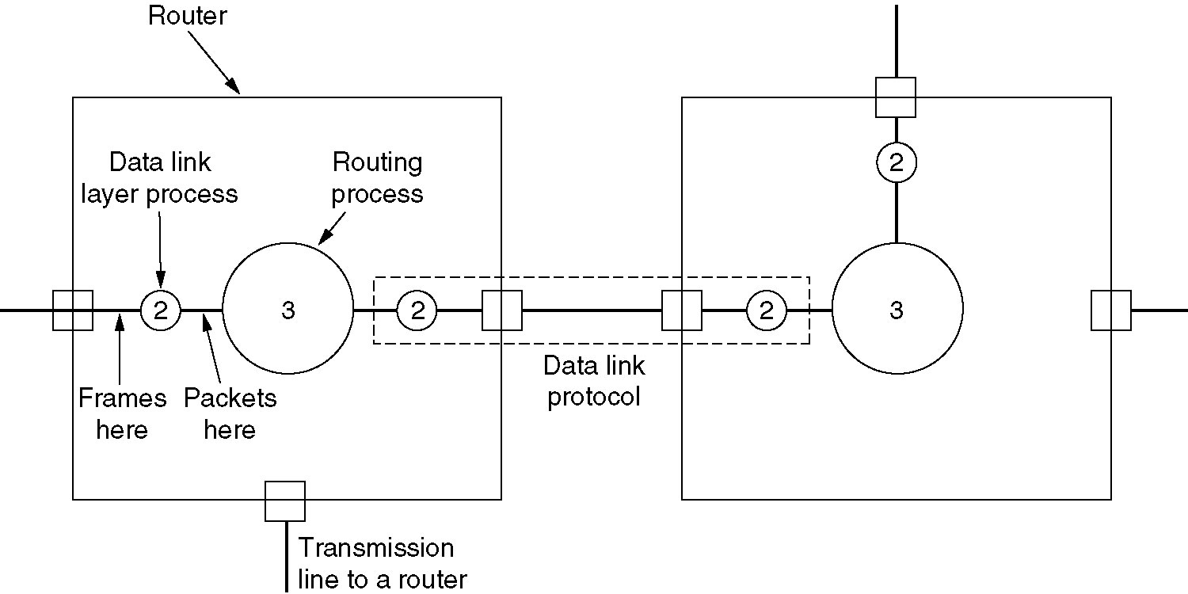
Services Provided to Network Layer (2)
Placement of the data link protocol.

Slide 8
Example: Connection oriented reliable service
Phase 1:
The connection is established. Both the sides initialize the variables and counters needed to keep track of which frame have been received and which one have not.
Phase 2:
One or more frames are actually transmitted.
Phase 3:
Connection is releases, freeing up the variables, buffers and other resources.

Slide 9
Framing
Physical layer accepts the row bit stream and attempts to deliver it to the destination. This bet stream is not guaranteed to be error free.
The number of bits may be less than what actually transmitted. Some of the bits may be garbled during transmission.
The data link layer breaks up this bit stream into discrete frames and computer checksum for each frame. This Check sum is used by receiving DLL entity to detect and correct errors if any.

Slide 10
Methods of Framing
Character count
Byte/char stuffing
Bit stuffing
Violating the Physical encoding scheme.

Slide 11
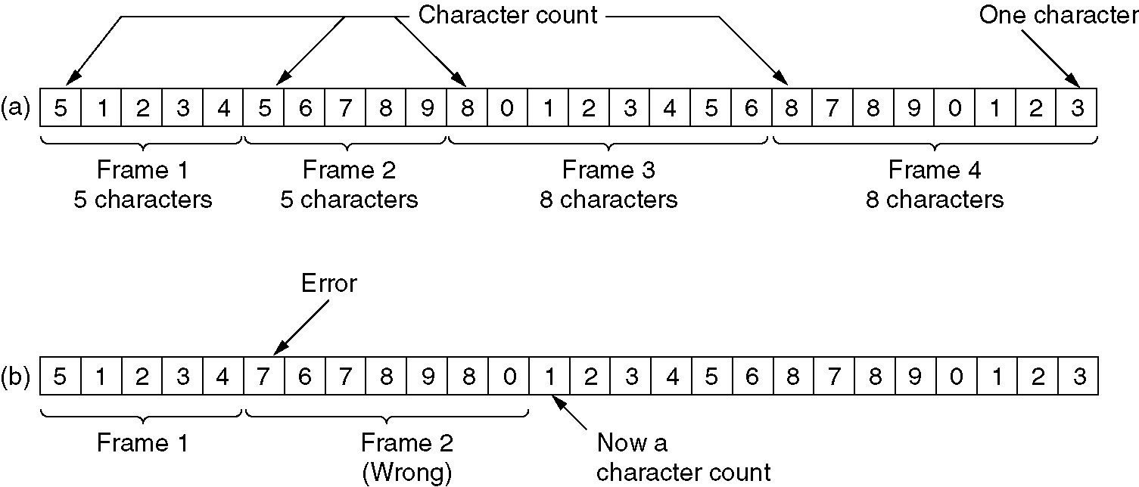
Framing – Character count
A character stream. (a) Without errors. (b) With one error.
Problem: If the count is garbled by the transmission error then the receiver will get out of the synchronization

Slide 12
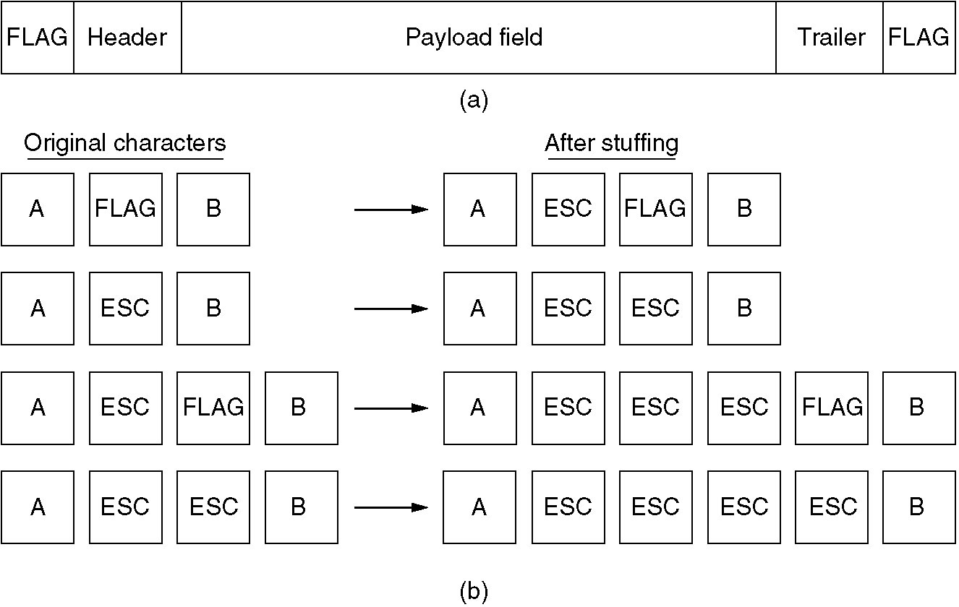
Framing – Byte/Char stuffing
(a) A frame delimited by flag bytes.
(b) Four examples of byte sequences before and after stuffing.
Problem: Closely tied to the use of 8-bit characters. Not all character code use 8-bits. For e.g. UNICODED uses 16-bit.

Slide 13
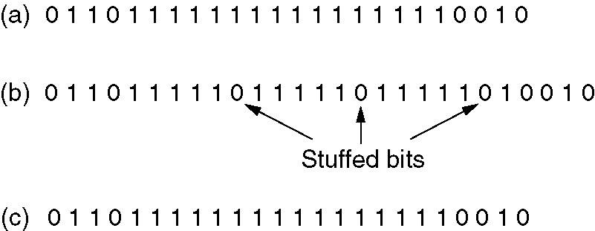
Framing (3) Bit stuffing
Bit stuffing
(a) The original data.
(b) The data as they appear on the line.
(c) The data as they are stored in receiver’s memory after de-stuffing.
Each frame begins and ends with a special bit pattern 01111110
When ever the sender’s data link layer identifies five consecutive 1’s it stuffs bit 0 into the outgoing stream.
Whenever receiver sees five consecutive 1’s followed by 0 it de-stuffs the 0 bit.

Slide 14
Bit stuffing
Advantages
Boundaries between two frames can be unambiguously identified.
It allows data frames to contain arbitrary number of bits and allows character codes with arbitrary number of bits per character.

Slide 15
Framing (4)
Violating the Physical encoding scheme.
Manchester encoding
1 bit – High-Low
0 bit – Low-High
The combination of Low-low and high-high are not used for data but are used for determining frame boundaries.

Slide 16
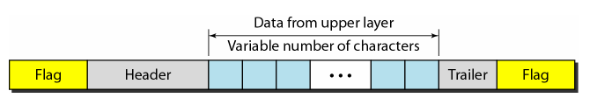
A frame in a character oriented protocol

Slide 17
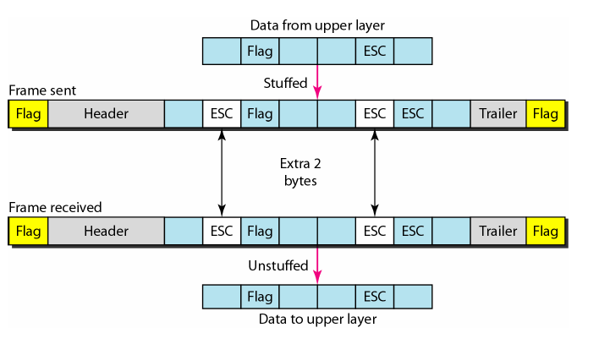
Byte stuffing and un-stuffing

Slide 18
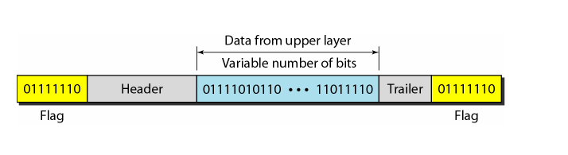
A Frame in a bit-oriented protocol

Slide 19
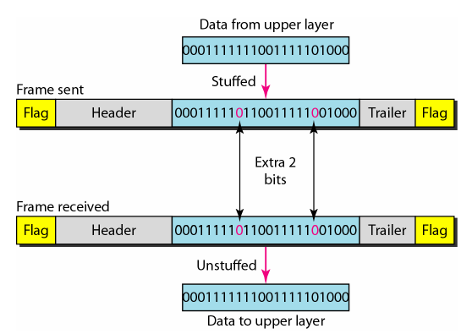
Bit stuffing and un-stuffing in bit-oriented protocol

Slide 20
Error detection and correction
Types of errors
Single bit error
Burst error

Slide 21
Error Detection Methods
Detection methods
VRC
LRC
CRC
CheckSum

Slide 22
Error Detection
Data transmission can contain errors
Single-bit
Burst errors of length n (n: distance between the first and last errors in data block)
How to detect errors
If only data is transmitted, errors cannot be detected → Send more information with data that satisfies a special relationship → Add redundancy

Slide 23
Error Detection Methods
Vertical Redundancy Check (VRC)
Append a single bit at the end of data block such that the number of ones is even → Even Parity (odd parity is similar) 0110011 → 01100110 0110001 → 01100011
VRC is also known as Parity Check
Performance:
Detects all single- bit errors
Detects all odd-number errors in a data block
Cannot detect even-number errors
Serial communications often uses vertical redundancy checking (VRC) when it adds a parity bit to the transmitted character.

Slide 24
Error Detection Methods
Longitudinal Redundancy Check (LRC)
LRC operate on groups of characters and described as message coding.
It adds a parity bit for all bits in the message at the same bit position.
It organizes data into a table. Then the parity bit for each column is calculated and a new row of eight bits, which are the parity bits for the whole block, is created.
After that the new calculated parity bits are attached to the original data and sent to the receiver.
LRC always uses even parity .
Suitable for detecting burst errors.

Slide 25
LRC
11100111 11011101 00111001 10101001
11100111
11011101
00111001
10101001
10101010
11100111 11011101 00111001 10101001 10101010
Original Data
LRC

Slide 26
Cannot detect (n+1) length burst error if only the first and last bit of burst is inverted and rest all intermediate bits remain unchanged.
Original Data:
11100111 11011101 00111001 10101001 10101010
Data received:
11100011 11011001 00111001 10101001
Compute checksum
11100011
11011001
00111001
10101001
---------------
10101010

Slide 27
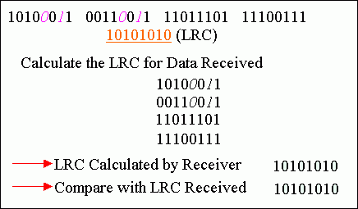
However, if two bits in one data unit are damaged and two bits in exactly the same positions in another data unit are also damaged, the LRC checker will not detect an error.

Slide 28
Error Detection Methods
Performance:
Detects all burst errors up to length n (number of columns)
Misses burst errors of length n+1 if there are n-1 uninverted bits between the first and last bit
If the block is badly garbled, the probability of acceptance is

Slide 29
Checksum
Checksum
Used by upper layer protocols
Similar to LRC, uses one’s complement arithmetic
Sender
The unit is divided into k sections, each of n bits
All sections are added together using 1’s complement arithmetic to get the sum
The sum is complemented and becomes the checksum
The checksum is sent with the data.
Receiver
The unit is divided into k sections, each of n bits
All sections are added together using 1’s complement arithmetic to get the sum.
The sum is complemented
If the result is zero, the data are accepted, otherwise discarded.

Slide 30
Example 1: Checksum
Data: 10101001 00111001
Add two numbers using 1’s complement
10101001
00111001
--------------
11100010 -→ sum using 1’s complement
00011101 -> complemented sum
append the sum
10101001 00111001 00011101

Slide 31
Example 1: Checksum (cont..)
At the receiver side:
Received data : 10101001 00111001 00011101
0 1 0 1 0 1 1 0
1 1 0 0 0 1 1 0
------------------
1 0 0 0 1 1 1 0 0
1
---------------------
0 0 0 1 1 1 0 1
+ 1 1 1 0 0 0 1 0
----------------------- complement
1 1 1 1 1 1 1 1 -------------→ 0 0 0 0 0 0 0 0

Slide 32
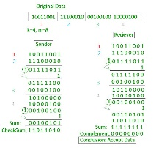
Example 2: Checksum

Slide 33
Cyclic redundancy Code
Unlike checksum scheme, which is based on addition, CRC is based on binary division.
In CRC, a sequence of redundant bits, called cyclic redundancy check bits, are appended to the end of data unit so that the resulting data unit becomes exactly divisible by a second, predetermined binary number.
At the destination, the incoming data unit is divided by the same number. If at this step there is no remainder, the data unit is assumed to be correct and is therefore accepted.
A remainder indicates that the data unit has been damaged in transit and therefore must be rejected.

Slide 34
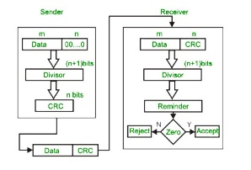
CRC - Flowchart

Slide 35
CRC (1)
CRC uses Generator Polynomial which is available on both sender and receiver side.
An example generator polynomial is of the form like x³ + x + 1. This generator polynomial represents key 1011. Another example is x² + 1 that represents key 101.
n : Number of bits in data to be sent from sender side.
k : Number of bits in the key obtained from generator polynomial.

Slide 36
CRC (2)
Sender Side (Generation of Encoded Data from Data and Generator Polynomial (or Key)):
The binary data is first augmented by adding k-1 zeros in the end of the data
Use modulo-2 binary division to divide binary data by the key and store remainder of division.
Append the remainder at the end of the data to form the encoded data and send the same
Receiver Side (Check if there are errors introduced in transmission) Perform modulo-2 division again and if remainder is 0, then there are no errors.

Slide 37
CRC (3)
CRC uses Modulo 2 division
Modulo 2 Division:
The process of modulo-2 binary division is the same as the familiar division process we use for decimal numbers. Just that instead of subtraction, we use XOR here.
In each step, a copy of the divisor (or data) is XORed with the k bits of the dividend (or key).
The result of the XOR operation (remainder) is (n-1) bits, which is used for the next step after 1 extra bit is pulled down to make it n bits long.
When there are no bits left to pull down, we have a result. The (n-1)-bit remainder which is appended at the sender side.

Slide 38
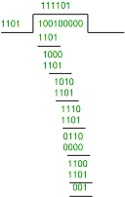
Data word to be sent - 100100 Key - 1101 [ Or generator polynomial x³ + x + 1]

Slide 39
CRC (4)
The error detection capabilities of cyclic code highly depends on the generator polynomial.
A good generator polynomial should have following characteristics.
It should have at least two terms
The coefficient of the term X⁰ should be 1
It should not divide x^{t}+1 for t between 2 and n-1
It should have the factor x+1

Slide 40
CRC (5)
If the generator has more than one term and co-efficient of x0 is 1 then all single bit errors can be caught.
A generator that contains factor (x+1) can detect all odd-numbered errors.
If a generator cannot divide xt+1 (t between 0 and 1) then all isolated double errors can be detected.

Slide 41
Why name cyclic??
Cyclic codes are special linear block codes with one extra property.
If a codeword is cyclically shifted (rotated) , the result is another codeword.
For example: 1011000 is a codeword
left shift → 0110001 is also a codeword

Slide 42
Data Link Control
Line Discipline
Framimg
Flow Control
Error Control
WCB/McGraw-Hill
© The McGraw-Hill Companies, Inc., 1998

Slide 43
Data Link Layer
WCB/McGraw-Hill
© The McGraw-Hill Companies, Inc., 1998

Slide 44
WCB/McGraw-Hill
© The McGraw-Hill Companies, Inc., 1998

Slide 45
WCB/McGraw-Hill
© The McGraw-Hill Companies, Inc., 1998

Slide 46
ENQ/ACK
Works for point-to-point link
Coordinates which device may start a transmission and whether or not intended receiver is ready.
WCB/McGraw-Hill
© The McGraw-Hill Companies, Inc., 1998

Slide 47
Figure 10-5
ENQ/ACK
WCB/McGraw-Hill
© The McGraw-Hill Companies, Inc., 1998

Slide 48
ENQ/ACK
Initiator transmits a frame called ENQ asking is the receiver is ready to receive data
If the receiver is ready will send ACK
If not ready will send NAK
If ACK/NAK is not received by the initiator it understands it is lost and resends the ENQ frame.
The initiator will make three such attempts before giving up.
If the response to the ENQ is NAK for three attempts the initiator disconnects and begin the process again at another time.

Slide 49
ENQ/ACK
If the response is positive the initiator is free to send data.
Once all of its data have been transmitted the initiator finishes with EOT.
No addressing is required for point-to-point configuration because there is a direct link between two machines..

Slide 50
Poll/Select
Used where one device is primary device and others are secondary devices.
Such systems are called multipoint.

Slide 51
How it works?
Whenever a multipoint link consists of a primary device and multiple secondary devices connected using a single transmission line, all exchanges must be made through the primary device.
The primary device controls the link, the secondary device follows its instructions.
It is up to the primary device to determine which device is allowed to use a channel at a given time.

Slide 52
Poll/Select continue
A primary is therefore is always an initiator of a session.
Poll:
The polling function is used by the primary device to solicit transmission from the sec. device. Here primary device ask secondary devices if they want to send data.
Select:
The select mode is used whenever the primary device has something to send. It also tells the target secondary to get ready to receive data.

Slide 53
Figure 10-6
Multipoint Discipline
WCB/McGraw-Hill
© The McGraw-Hill Companies, Inc., 1998

Slide 54
Select
WCB/McGraw-Hill
© The McGraw-Hill Companies, Inc., 1998

Slide 55
Poll
WCB/McGraw-Hill
© The McGraw-Hill Companies, Inc., 1998

Slide 56
Why flow control is needed?
Flow control is a set of procedures used to restrict the amount of data the sender can send before an ack from the receiver.
The flow of data must not be allowed to overwhelm the receiver.
Any receiver has a limited speed at which it can process data and a limited amount of memory in which it can store incoming data.
The receiving device must be able to inform the sender before those limits are reached.

Slide 57
Figure 10-9
WCB/McGraw-Hill
© The McGraw-Hill Companies, Inc., 1998

Slide 58
Stop and wait
Sender waits for an ack after every frame it sends.
Only when an ack arrives it sends the next frame.
This process of alternately sending and waiting repeats until the sender transmits EOT - End Of Transmission

Slide 59
Figure 10-10
Stop and Wait
WCB/McGraw-Hill
© The McGraw-Hill Companies, Inc., 1998

Slide 60
Stop and wait
Advantage: Simplicity
Disadvantage: Inefficient
If the distance between two nodes is long, time spent would be very high.

Slide 67
Stop and wait -Data Frame Transmission
Unidirectional assumption
⇒ Not general
Full-duplex - approach 1
Two separate communication channels
Forward channel for data
Reverse channel for acknowledgement
⇒ Problems: 1. reverse channel bandwidth wasted
2. cost

Slide 68
Data Frame Transmission
Full-duplex - approach 2
Same circuit for both directions
Data and acknowledgement are intermixed
How do we tell acknowledgement from data?
"kind" field telling data or acknowledgement
Can it be improved?
Approach 3
Attaching acknowledgement to outgoing data frames
⇒ Piggybacking

Slide 69
Piggybacking
Temporarily delaying transmission of outgoing acknowledgement so that they can be hooked onto the next outgoing data frame.
Advantage: higher channel bandwidth utilization
Complication:
How long to wait for a packet to piggyback?
If longer than sender timeout period then
sender retransmit
⇒ Purpose of acknowledgement is lost

Slide 70
Piggybacking
Solution for timing complexion
If a new packet arrives quickly
⇒ Piggybacking
If no new packet arrives after a receiver ack timeout
⇒ Sending a separate acknowledgement frame

Slide 72
Sliding Window Protocol
We are going to study three bidirectional sliding window protocols
(max sending window size, receiving window size)
One-bit sliding window protocol (1, 1)
Go back N (>1, 1)
Selective repeat (>1, >1)
Differ in efficiency, complexity, and buffer requirements

Slide 73
Sliding Window Protocol
Each outbound frame contains an n-bit sequence number
Range: 0 - MAX_SEQ (MAX_SEQ = 2^{n} - 1)
For stop-and-wait, n = 1. Why?
At any instance of time
Sender maintains a set of sequence numbers of frames permitted to send
These frames fall within sending window
Receiver maintains a set of sequence numbers of frames permitted to accept
These frames fall within receiving window

Slide 74
Sliding Window Protocol
Lower limit, upper limit, and size of two windows need not be the same
Fixed or variable size
Requirements
Packets delivered to the receiver's network layer must be in the same order that they were passed to the data link layer on the sending machine
Frames must be delivered by the physical communication channel in the order in which they were sent

Slide 75
Sending Window
Contains frames that can be sent or have been sent but not yet acknowledged – outstanding frames
When a packet arrives from network layer
Next highest sequence number assigned
Upper edge of window advanced by 1
When an acknowledgement arrives
Lower edge of window advanced by 1

Slide 76
Sending Window
If the maximum window size is n, n buffers is needed to hold unacknowledged frames
Window full (maximum window size reached)
⇒ shut off network layer

Slide 77
Receiving Window
Contains frames may be accepted
Frame outside the window ➔ discarded
When a frame's sequence number equals to lower edge
Passed to the network layer
Acknowledgement generated
Window rotated by 1

Slide 78
Receiving Window
Contains frames may be accepted
Always remains at initial size (different from sending window)
Size
=1 means frames only accepted in order
>1 not so
Again, the order of packets fed to the receiver’s network layer must be the same as the order packets sent by the sender’s network layer

Slide 79
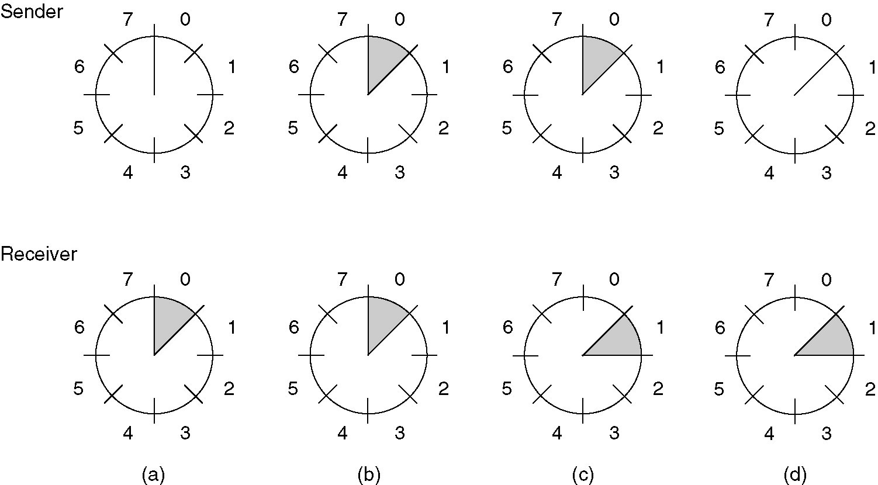
Actually, 1-bit sequence number is enough for this example. The purpose of using 3-bit is to demonstrate the idea of sliding window.
A sliding window of size 1, with a 3-bit sequence number.
(a) Initially.
(b) After the first frame has been sent.
(c) After the first frame has been received.
(d) After the first acknowledgement has been received.
In many textbooks, an array of boxes are used to represent the window.

Slide 80
One Bit Sliding Window Protocol
Sending window size = receiving window size = 1
Stop-and-wait
Acknowledgement =
Sequence number of last frame received w/o error*
Problem of sender and receiver send simultaneously
*: some protocols define the acknowledgement to be the sequence number expected to receive

Slide 81
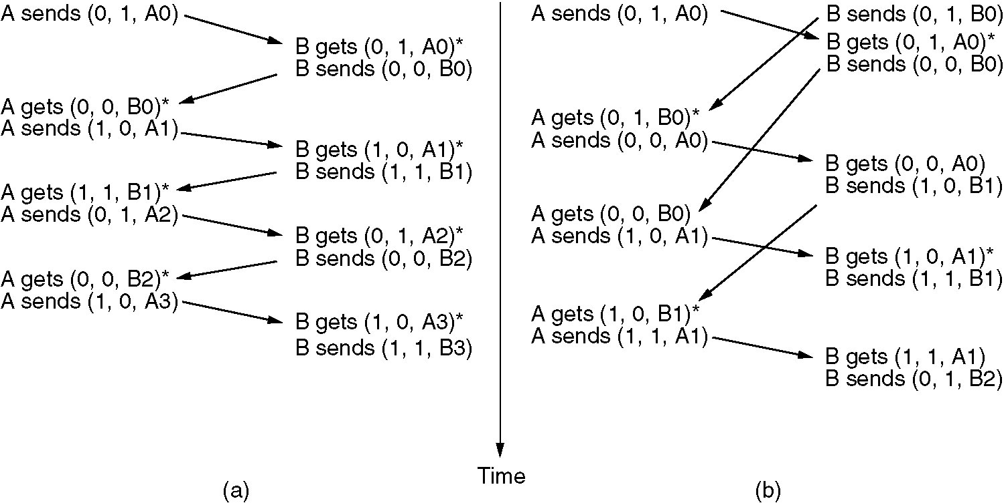
Case 1: normal case
Case 7: simultaneous start
(a) Case 1: Normal case. (b) Case 7: Abnormal case. The notation is (seq, ack, packet number). An asterisk indicates where a network layer accepts a packet.
Try to draw the sending windows and receiving windows for A and B!

Slide 82
Go Back n Protocol
Receiver discards all subsequent frames following an error one, and send no acknowledgement for those discarded
Receiving window size = 1 (i.e., frames must be accepted in the order they were sent)
Sending window might get full
If so, re-transmitting unacknowledged frames
Wasting a lot of bandwidth if error rate is high

Slide 83
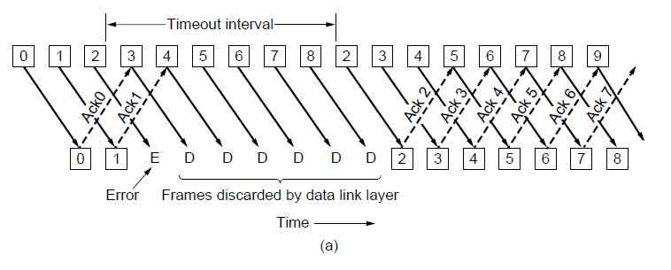
Go Back n Protocol

Slide 84
Go Back n Protocol
S
R
0 1 2 3 0 1 2 3 0
Time
Frame 0
0 1 2 3 0 1 2 3 0
0 1 2 3 0 1 2 3 0
0 1 2 3 0 1 2 3 0
Frame 1
0 1 2 3 0 1 2 3 0
ACK 1
0 1 2 3 0 1 2 3 0
Frame 2
0 1 2 3 0 1 2 3 0
ACK 2
0 1 2 3 0 1 2 3 0
0 1 2 3 0 1 2 3 0
Frame 3
0 1 2 3 0 1 2 3 0

Slide 85
Go Back n Protocol
What is the maximum sending window size?
Maximum sending window size of = MAX_SEQ, not MAX_SEQ+1
With n-bit sequence number, MAX_SEQ = 2^{n} – 1, maximum sending window size = 2^{n} - 1
e.g., for 3-bit window, MAX_SEQ = 7, so window size = 7 although max. size could be 8
Why?

Slide 86
Go Back n Protocol - Window Size
Suppose 3-bit window is used and max sending window size = MAX_SEQ+1 = 8
Sender sends frames 0 through 7
Piggybacked ack 7 comes back
Sender sends anther 8 frames w/ sequence numbers 0 through 7
Another piggybacked ack 7 comes back
Q: Did all second 8-frames arrive successfully or did all of them get lost?
Ack 7 for both cases ⇒ Ambiguous
⇒ Max. window size = 7

Slide 87
Go Back n Protocol Implementation
Sender has to buffer unacknowledged frames
Acknowledge n means frames n,n-1,n-2, ... are acknowledged (i.e., received correctly) and those buffers can be released
One timer for each outstanding frame in sending window

Slide 88
Select Repeat Protocol
Receiver stores correct frames following the bad one
Sender retransmits the bad one after noticing
Receiver passes data to network layer and acknowledge with the highest number
Receiving window > 1 (i.e., any frame within the window may be accepted and buffered until all the preceding one passed to the network layer
Might need large memory

Slide 89
Negative Acknowledgement (NAK)
SRP is often combined with NAK
When error is suspected by receiver, receiver request retransmission of a frame
Arrival of a damaged frame
Arrival of a frame other than the expected
Does receiver keep track of NAK?
What if NAK gets lost?
To nak, or not to nak: that is the question

Slide 90
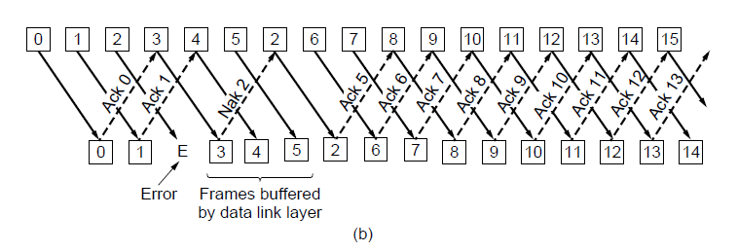
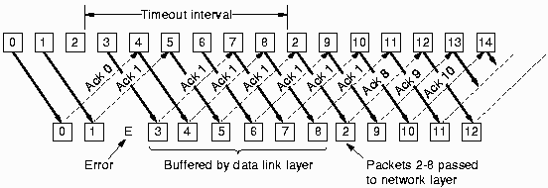
Selective Repeat with NAK
Nak 2, lost

Slide 91
Selective Repeat with NAK
S
R
0 1 2 3 0 1 2 3 0
Time
Frame 0
0 1 2 3 0 1 2 3 0
0 1 2 3 0 1 2 3 0
0 1 2 3 0 1 2 3 0
0 1 2 3 0 1 2 3 0
Frame 1
ACK 1
0 1 2 3 0 1 2 3 0
0 1 2 3 0 1 2 3 0
Frame 2
X
0 1 2 3 0 1 2 3 0
Frame 3
NAK 2
0 1 2 3 0 1 2 3 0
0 1 2 3 0 1 2 3 0
Frame 2
0 1 2 3 0 1 2 3 0
ACK or NAK?
Where’s the window now?
0 1 2 3 0 1 2 3 0
Where’s the window now?

Slide 92
Select Repeat Protocol Implementation
Receiver has a buffer for each sequence number within receiving window
Each buffer is associated with an "arrived" bit
Check whether sequence number of an arriving frame within window or not
If so, accept and store
Maximum window size = ? Can it be MAX_SEQ ?

Slide 93
Select Repeat Protocol - Window Size
Suppose 3-bit window is used and window size = MAX_SEQ = 7
sender receiver
0 1 2 3 4 5 6 sent 0 1 2 3 4 5 6 accepted
0 through 6 to network layer
all acknowledgements lost
0 retransmitted 0 accepted
ack 6 received
7 sent 7 accepted
7 and 0 to network layer

Slide 94
Select Repeat Protocol - Window Size
Problem is caused by new and old windows overlapped
Solution
Window size=(MAX_SEQ+1)/2
E.g., if 4-bit window is used, MAX_SEQ = 15
⇒ window size = (15+1)/2 = 8
Number of buffers needed
= window size

Slide 95
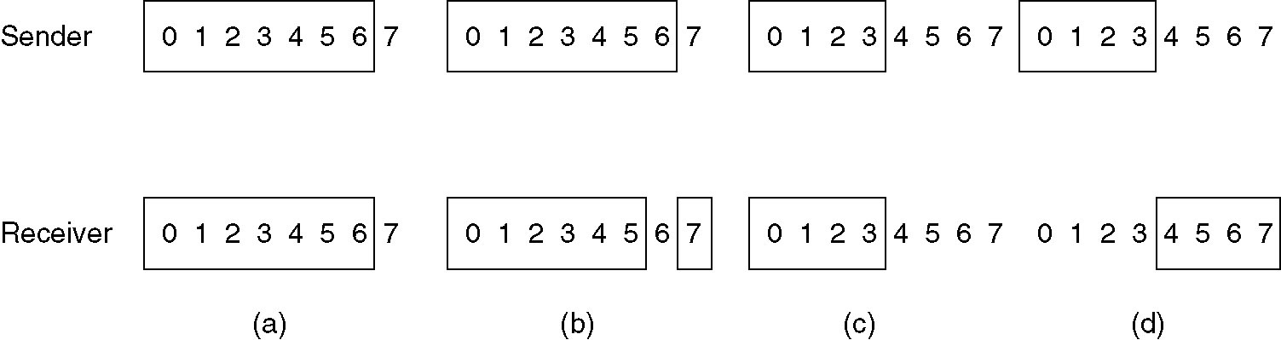
Select Repeat Protocol
(a) Initial situation with a window size seven.
(b) After seven frames sent and received, but not acknowledged.
(c) Initial situation with a window size of four.
(d) After four frames sent and received, but not acknowledged.

Slide 96
Acknowledgement Timer
Problem
If the reverse traffic is light, effect?
If there is no reverse traffic, effect?
Solution
Acknowledgement timer:
If no reverse traffic before timeout
send separate acknowledgement
Essential: ack timeout < data frame timeout Why?

Slide 97
Efficiency
Transmission Delay (Tt) – Time to transmit the packet from host to the outgoing link. If B is the Bandwidth of the link and D is the Data Size to transmit. Tt = D/B
Propagation Delay (Tp) – It is the time taken by the first bit transferred by the host onto the outgoing link to reach the destination. It depends on the distance d and the wave propagation speed s (depends on the characteristics of the medium). Tp= D/S
Efficiency – It is defined as the ratio of total useful time to the total cycle time of a packet. For stop and wait protocol,
Total time = Tt + 2 * (Tp)
Efficiency = useful time/ total time
= Tt / (Tt + 2 * (Tp))
= 1 / (1+ 2a) where a = Tp/Tt

Slide 98
In Tt units ----> 1 packet is Transmitted.
In 1 units ----> 1/Tt packet can be Transmitted.
In Tt + 2*Tp units -----> (Tt + 2*Tp)/Tt
packets can be Transmitted
------> 1 + 2a [Using a = Tp/Tt]
Maximum packets That can be Transmitted in total cycle time = 1+2*a

Slide 99
Consider Tt = 1ms, Tp = 1.5ms.
In the picture given below, after sender has transmitted packet 0, it will immediately transmit packets 1, 2, 3. Acknowledgement for 0 will arrive after 2*1.5 = 3ms. In Stop and Wait, in time 1 + 2*1.5 = 4ms, we were transferring one packet only. Here we keep a window of packets which we have transmitted but not yet acknowledged.

Slide 100
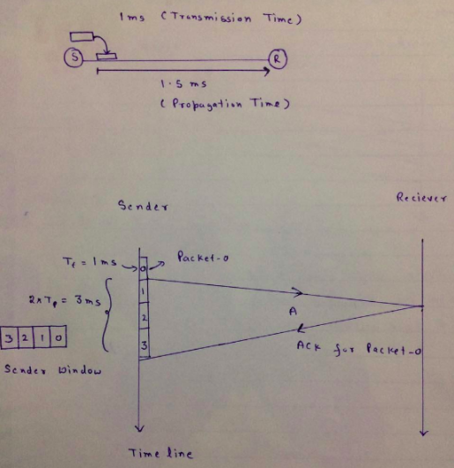

Slide 101
Sliding Window Protocol
Sender can transmit several frames before needing an ack.
Frames can be sent one right after another
The receiver ack only some of the frames, using single ack to confirm the receipt of multiple data frames.

Slide 102
Sliding window protocol
Both sender and the receiver maintains an imaginary window called the sliding window.
If the size of the window is n then the frames are numbered modulo-n that means they are numbered from 0 to n-1 that is 0,1,2,3,4,5,6,7,0,1,2,3,4,5,6,7,0,1,….
The window can hold at most n-1 frames at either end.
When the receiver sends an ack it sends the next frame it expects to receive. This automatically acknowledges the receipt of the earlier frames.
For e.g ack containing number 5 automatically ack frames numbered 1 to 4

Slide 103
Figure 10-11
Sliding Window
WCB/McGraw-Hill
© The McGraw-Hill Companies, Inc., 1998

Slide 104
The sender window
At the beginning of a transmission , the sender window contains n-1 frames.
As frames are sent out the left boundary of the window moves inward shrinking the size of the window.
As ACK arrives the right boundary of the window moves outwards expanding the window, thus allowing in a number of new frames equal to the number of frames acknowledged.

Slide 105
Figure 10-12
Sender Sliding Window
WCB/McGraw-Hill
© The McGraw-Hill Companies, Inc., 1998

Slide 106
The receiver sliding window
At the beginning the receiver window contains n-1 spaces to buffer n-1 frames that it expects to receive from the sender.
As a new frame comes in the size of the window shrinks. The left boundary moves inward.
As the frames is processed and ack is sent the size of the window expands by moving right edge of the window outwards.
Thus receiver’s window represents the number of frames the receiver expects from the sender.
E.g Given the window size w if three frames are received the number of spaces in window will become w-3.
As soon as ack is sent the window expands to includes places for a number of frames equal to the number of frames acknowledged.

Slide 107
Figure 10-13
Receiver Sliding Window
WCB/McGraw-Hill
© The McGraw-Hill Companies, Inc., 1998

Slide 108
Figure 10-14
Sliding Window Example
WCB/McGraw-Hill
© The McGraw-Hill Companies, Inc., 1998

Slide 109
Figure 10-14-continued
Sender
WCB/McGraw-Hill
© The McGraw-Hill Companies, Inc., 1998

Slide 110
Figure 10-14-continued
Receiver
WCB/McGraw-Hill
© The McGraw-Hill Companies, Inc., 1998

Slide 111
The window size
It is important to note that the window can hold at most n-1 frames. That is the size of the window is always one less than modulo range.
Assume that the frame sequence numbers are modulo-8 and the window size is also 8.
Now imagine that the frame 0 has been sent and ack 1 is revceived. The sender expands its window and sends 1,2,3,4,5,6,7 and 0.
If it now receives ack1 again it cannot tell whether this is a duplicate of previous ack 1 or confirming the most recently sent eight frames.

Slide 112
Error control
What is ARQ-Automatic Repeate Request
ARQ is implemented in DLL as an adjunct to flow control
If the frames are damages or lost or acknowledgement is lost then data link layer protocol requests the sender or receiver to retransmit the frame.

Slide 113
Figure 10-15
WCB/McGraw-Hill
© The McGraw-Hill Companies, Inc., 1998

Slide 114
Stop-and- wait ARQ
Form of stop-and-wait flow control to include retransmission of damaged or lost frames.

Slide 115
Stop-and-wait ARQ
The sender keeps a copy of the sent frames until it receives an ack.
For identification both data frames and ACK frames are numbered alternately 0 and 1.
A data 0 frame is acknowledged by ack 1 and data 1 is acknowledged by ack0.
If an error is discovered in a data frame, a NAK frame is returned.
NAK frames are not numbered. They give a negative ack for the last frame sent by the sender.
When a sender receives a NAK it retransmits the frame transmitted after the last acknowledgement.
The sending device is equipped with a timer. If an expected ack does not arrives within a specified time period, timer expires and triggers retransmission.

Slide 116
Figure 10-16
Damaged Frame
Sender
Receiver
Data 0
Ack 1
Data 1
Ack 0
Data 0
NAK
Data 0
Ack 1
WCB/McGraw-Hill
© The McGraw-Hill Companies, Inc., 1998

Slide 117
Figure 10-17
Lost Frame
Sender
Receiver
Data 0
Lost
Timeout
Data 0
Ack 1
WCB/McGraw-Hill
© The McGraw-Hill Companies, Inc., 1998

Slide 118
Figure 10-18
Lost ACK
Sender
Receiver
Data 0
Timeout
Ack 1
Lost
Data 0
Second copy discarded
Ack 1
WCB/McGraw-Hill
© The McGraw-Hill Companies, Inc., 1998

Slide 119
Sliding window ARQ
Following features are added to basic flow control
The sending device keeps copies of all sent frames until they are acknowledged.
In addition to ack frames the receiver has the option to send NAK frame is frames have been damaged. NAK frames tells the receiver to retransmit the damaged frame.
Both ACK and NAK frames must be numbered.
ACK frames carry the number of the next frame expected by the receiver
NAK frame carries the number of the damaged frame itself.
Data frames received without error need not to be acknowledged individually.

Slide 120
Sliding window ARQ
7 If the last ack was numbered 3 and now the next ack received is numbered 6 automatically gives the receipt of frames 4 and 5.
Every damaged frame however be acknowledged by NAK
Every sending device is equipped with a timer to enable it to handle lost ack.
N-1 frames may be sent before an ack must be received.
Sliding window ARQ can be implemented using two protocols
Using Go-Back –N
And using Selective Reject

Slide 121
Protocol using Go-Back-N
If one frame is lost or damaged , all frames sent since the last frame acknowledged are retransmitted.

Slide 122
Protocol using Go-back-N
In case of damaged frames :
As soon as the receiver discovers an error in a frame it stops receiving the subsequent frames until the damaged frame has been replaced correctly..
Actually NAK indicates two things
1. Positive ack of all the frames received prior to the damaged frames
2. A NAK for a frame indicated.
If the first ack is NAK3 it indicated positive ack for the frame 0,1,2 and negative ack for frame 3.

Slide 123
Figure 10-19
Damaged Frame
WCB/McGraw-Hill
© The McGraw-Hill Companies, Inc., 1998

Slide 124
Protocol using go-Back-N
In case of lost data frames:
Sliding window requires all data be transmitted sequentially.
The receiver check the frame number, discovers that one or more frames have been skipped and returns a NAK for the first missing frame.
A NAK frame does not indicate whether it is damaged or lost, just indicates it has to be resent.
The sender then resent the frame for which it receives NAK as well as any frames sent after the lost one.

Slide 125
Figure 10-20
Lost Frame
WCB/McGraw-Hill
© The McGraw-Hill Companies, Inc., 1998

Slide 126
Protocol using Go-Back-N
In case of Lost ack
Here the sender uses timer.
Sender can send as many frames as the window allows before waiting for an ack.
Once the limit has been reached or the sender has no more frames to send it starts timer.
If an ack does not received within the specified time limit , the sender retransmits every frame transmitted since the last ack.

Slide 127
Figure 10-21
Lost ACK
WCB/McGraw-Hill
© The McGraw-Hill Companies, Inc., 1998

Slide 128
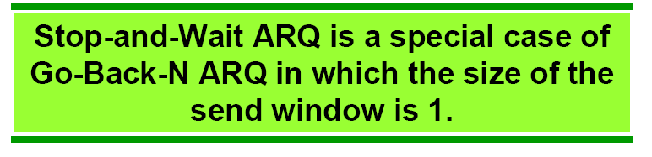

Slide 129
Selective Reject
Unlike Go-back-N here only the specific damaged or lost frame is retransmitted
If a frame is corrupted in transit NAK is returned and the frame is resent.
The receiving device must be able to sort the frames it has and insert the retransmitted frame into the proper place in the sequence.

Slide 130
Selective Reject
The receiver device must contain sorting logic to enable to reorder frames received out of sequence.
It must also be able to store frames received after the damaged frames, until that damaged frame is received correctly.
The sending device must contain the searching mechanism that allows to find and select only the requested frame for retransmission.
A buffer in the receiver must keep all previously received frames on hold until all retransmission have been sorted and any duplicate frames have been identified and discarded.
This complexity requires a smaller window size than is needed by the Go-Back-N.
It is recommended that that the window size be less than or equal to (n+1)/2 for selective reject

Slide 131
Figure 10-22
Selective Reject
WCB/McGraw-Hill
© The McGraw-Hill Companies, Inc., 1998

Slide 132
Comparison between Go-Back-N and selective reject
Selective reject is expensive than Go-Back-N
- Complex sorting is required
- Additional Buffer for storing frames received after the damaged or lost frames.
- Extra logic needed by the sender to select specific frame for retransmission.
b) Go-Back-N is simple and preferable due to the complexity of Selective reject. But performance wise selective reject is better.

Slide 133
Example Data Link Protocols
HDLC – High-Level Data Link Control
The Data Link Layer in the Internet

Slide 134
Example : Data Link Protocols
Asynchronous Protocols
Synchronous Protocols
Character-Oriented Protocols
Bit-Oriented Protocols
WCB/McGraw-Hill
© The McGraw-Hill Companies, Inc., 1998

Slide 135
Figure 11-1
WCB/McGraw-Hill
© The McGraw-Hill Companies, Inc., 1998

Slide 136
Figure 6-3
Serial Transmission
WCB/McGraw-Hill
© The McGraw-Hill Companies, Inc., 1998

Slide 137
Asynchronous Protocol
They treat each character in a bit stream independently
Data is transmitted with no timing coordination between sender and receiver.
A receiver need not to know when exactly data has been sent. It only needs to recognize the beginning and end of the unit.
This is done using start and stop bits.
Relatively Slow
Not complex and are inexpensive to implement
Used in Modem

Slide 138
Figure 6-4
Asynchronous Transmission
WCB/McGraw-Hill
© The McGraw-Hill Companies, Inc., 1998

Slide 139
Synchronous protocol
Synchronous protocols take the whole bit stream and divide characters of equal size.
Speed is high

Slide 140
Figure 6-5
Synchronous Transmission
WCB/McGraw-Hill
© The McGraw-Hill Companies, Inc., 1998

Slide 141
Figure 11-2
WCB/McGraw-Hill
© The McGraw-Hill Companies, Inc., 1998

Slide 142
Figure 11-4
BSC( Binary Synchronous Communication)
SDLC
HDLC
LAP
WCB/McGraw-Hill
© The McGraw-Hill Companies, Inc., 1998

Slide 143
Character oriented protocol
In all Data link layer protocol, control information is inserted into data stream either as a separate control frame or as additions to existing data frames.
In character–oriented protocol this information is in the form of code word words taken from existing character set such as ASCII or EBCDIC.
These characters may carry information about discipline, flow control and error control.

Slide 144
HDLC

Slide 145
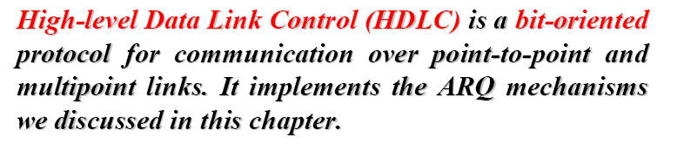
HDLC

Slide 146
HDLC (Continued)
Designed to support both half-duplex and full-duplex communication over point-to-point and multipoint links.
Station types:
HDLC differentiates between three stations
Primary: sends commands
Secondary: Only sends response
combined: sends command / response
Configuration: Supports three types of configurations
Unbalanced:
Symmetrical:
balanced:

Slide 147
HDLC (Contd..)
Three modes of communication
NRM (Normal Response Mode)
The station configuration is unbalanced. Means there is one primary device and one or more secondary devices.. A primary station can send command and sec. devices can only send response.
ABM (Asynchronous Balanced Mode)
All stations are equal and therefore all machines are of type combined. All machines can send command as well as response.

Slide 148
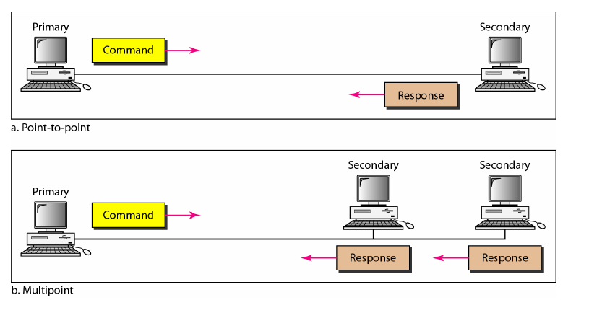
HDLC Configuration
Unbalanced configuration

Slide 149
Figure 11-14-continued
HDLC Configuration
Balanced Point-to-point
WCB/McGraw-Hill
© The McGraw-Hill Companies, Inc., 1998

Slide 150
HDLC Frames
Supports three types of frames
Information frame (I-frame)
Supervisory frame (S-frame)
Unnumbered frames (U-frames)

Slide 151
Figure 11-16
HDLC Frame Types
Used to transport User data
WCB/McGraw-Hill
© The McGraw-Hill Companies, Inc., 1998

Slide 152
Figure 11-16-continued
HDLC Frame Types
Used to transport control information such as flow control and error control
WCB/McGraw-Hill
© The McGraw-Hill Companies, Inc., 1998

Slide 153
Figure 11-16-continued
HDLC Frame Types
Reserved for system management
Used to exchange session management and control information between devices.
WCB/McGraw-Hill
© The McGraw-Hill Companies, Inc., 1998

Slide 154
Figure 11-17
HDLC Flag Field
Flag fields identifies both start and the end of the frame and also servers as synchronization pattern
WCB/McGraw-Hill
© The McGraw-Hill Companies, Inc., 1998

Slide 155
Figure 11-19
HDLC Address Field
Contains the address of the secondary device.
If primary station creates a frame then it contains to address.
If a sec creates a frame it contains the from address
WCB/McGraw-Hill
© The McGraw-Hill Companies, Inc., 1998

Slide 156
Figure 11-20
HDLC Control Field
WCB/McGraw-Hill
© The McGraw-Hill Companies, Inc., 1998

Slide 157
Figure 11-22
HDLC Information Field
WCB/McGraw-Hill
© The McGraw-Hill Companies, Inc., 1998

Slide 158
Figure 11-23
HDLC FCS Field
WCB/McGraw-Hill
© The McGraw-Hill Companies, Inc., 1998

Slide 159
Figure 11-24
WCB/McGraw-Hill
© The McGraw-Hill Companies, Inc., 1998

Slide 160
HDLC – Control field
RR (Receive Ready)
Positive Ack: Used by the receiver to send positive ack of the frame. Only acknowledgement without piggybacking.
Poll: When used by primary with P bit set, RR asks the secondary whether it has data to send.
Negative response to poll: If sec does not have any data to send it responds with RR and F bit set. If it has data then it sends I frame to primary.

Slide 161
HDLC – Control field
Reject
REJ is the NAK used in Go-back-N ARQ error correction technique when receiver does not have data on which it can piggyback the ack. Here N(R ) field contains sequence number of the damaged frame.
Selective Reject
A NAK in selective reject ARQ

Slide 162
Figure 11-26
U-Frame Control Field
Total 32 codes are possible.
WCB/McGraw-Hill
© The McGraw-Hill Companies, Inc., 1998

Slide 163
Figure 11-26-continued
U-Frame Control Field
WCB/McGraw-Hill
© The McGraw-Hill Companies, Inc., 1998

Slide 164
The Data Link Layer in the Internet
Here we will discuss the data link protocol used on point-to-point lines in the Internet
Point-to-point communication in internet
Point-to-pint links are used in two cases.
1)
Thousands of organizations have one or more LANs each with some number of hosts, along with a router.
Often routers are connected with a backbone LAN.
Typically all connections to the outside world is trough routers that have point-to-point leased lines to distant routers. So they are used between two routers connected via a point-to-point ink.

Slide 165
DaThe Data Link Layer in the Internet
2)
Another situation where point-to-point link is used is where millions of home PCs connect to the internet via dial-up telephone lines.
User’s home PC calls up an internet service provider’s router and then can work as full-blown internet host.
Thus for both router-router leased line connection and a dial-up host –router connection some point-to-point data link control protocol is used.

Slide 166
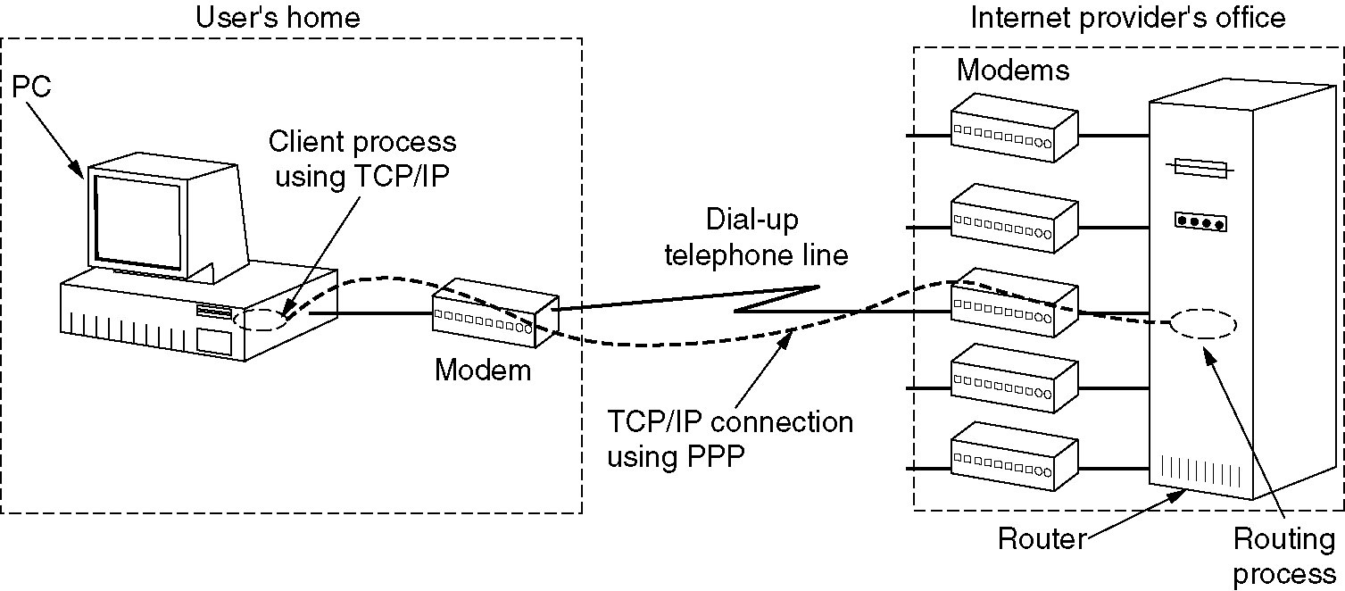
The Data Link Layer in the Internet
A home personal computer acting as an internet host.

Slide 167
Point-to-point protocol (PPP)
The internet needs a point-to-point protocol for a variety of purposes, including router-router traffic and host -router traffic.
PPP handles
- error detection
- Permits authentication
- allows IP addresses to be negotiated at connection time
- Supports multiple protocols
PPP provides three features
1. Framing method
2. LCP – Link control protocol
3. NCP – Network control protocol

Slide 168
Point-to-point protocol (PPP)
What does it Not provide??
Does not provides flow control and error control
Does not provide ARQ, If the frame is corrupted , it is silently discarded. The upper layer needs to take care of it.
Lack of flow control/ and error control may cause out of order packets.
Does not work for multi point configuration.

Slide 169
PPP (Contd..)
LCP :The LCP deals with bringing lines up, testing them, negotiating options, and bringing them down again gracefully when no longer needed. It supports both synchronous and asynchronous acks and also character and bit oriented encoding.
NCP: It negotiates the network layer options that are independent of the network layer protocol to be used.

Slide 170
Working of PPP using an example
Consider the typical scenario of home user calling the internet service provider to make PC a temporary internet host.
The PC first calls the service provider’s router via a modem.
After router’s modem has answered the phone and established a physical connection, the PC sends the router the series of LCP packets in the payload field of PPP frames
These packets and their response selects the PPP parameters to be used.
Once the parameters have been agreed upon, a series of NCP packets are sent to configure the network layer.
Typically the PC wants the IP address. NCP assigns this IP address.
At this point the PC is now an internet host and can send/receive packets.

Slide 171
Working of PPP using an example
When the user is finished, NCP tears down the NCP connection and frees up the IP address.
Then LCP shut down the data link layer connection.
Finally the computer tells the modem to hang up the phone, releasing the physical layer connection.

Slide 172
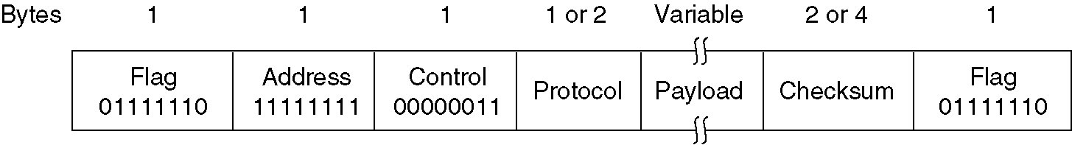
PPP – Point to Point Protocol
The PPP full frame format for unnumbered mode operation.

Slide 173
PPP Frame format
Flag: Frame begins with a standard HDLC flag byte 01111110. which is byte stuffed it occurs in data. Note that PPP is byte oriented protocol.
Address field is always 11111111 indicating frame must be accepted by all stations.
Control field: default is 00000011. It indicates unnumbered frames. PPP does not provides reliable transmission using seq. numbers and ack by default. For a noisy channel reliable transmission using numbered mode can be used.
Protocol field specifies the what kind of packet is there in the payload field. Example LCP, IP, IPX, NCP etc. Protocol field is of 2-byes but can be negotiated own to 1-byte.
Protocols starting with 0 bit are the network layer protocol
Protocols starting with 1 bit are used to negotiate other protocols.

Slide 174
PPP Frame format
Checksum: Check sum which is normally 2-byte or 4-byte that can be negotiated.

Slide 175
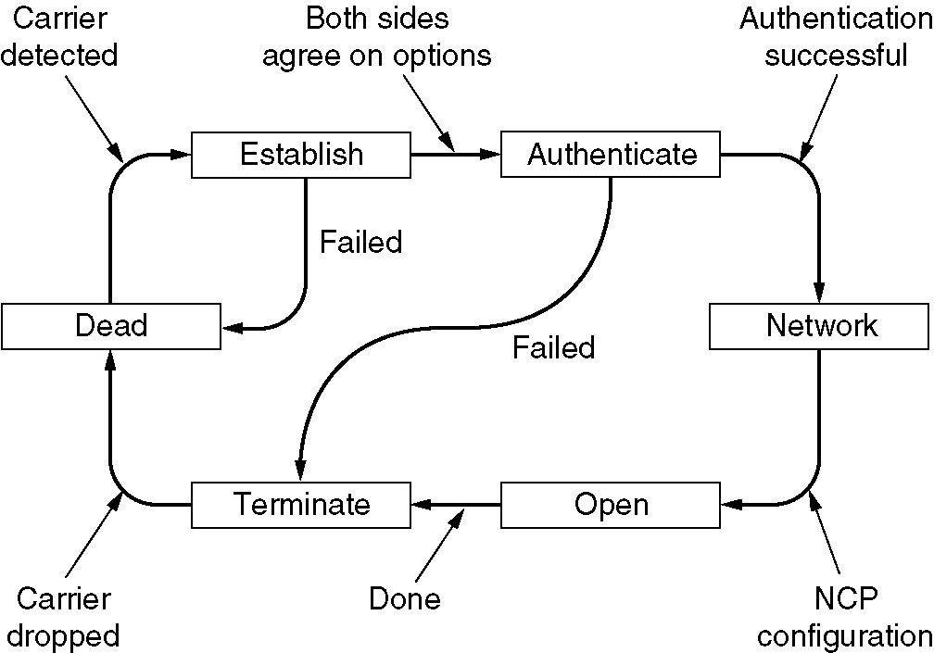
PPP – Point to Point Protocol (2)
A simplified phase diagram for bring a line up and down.

Slide 176
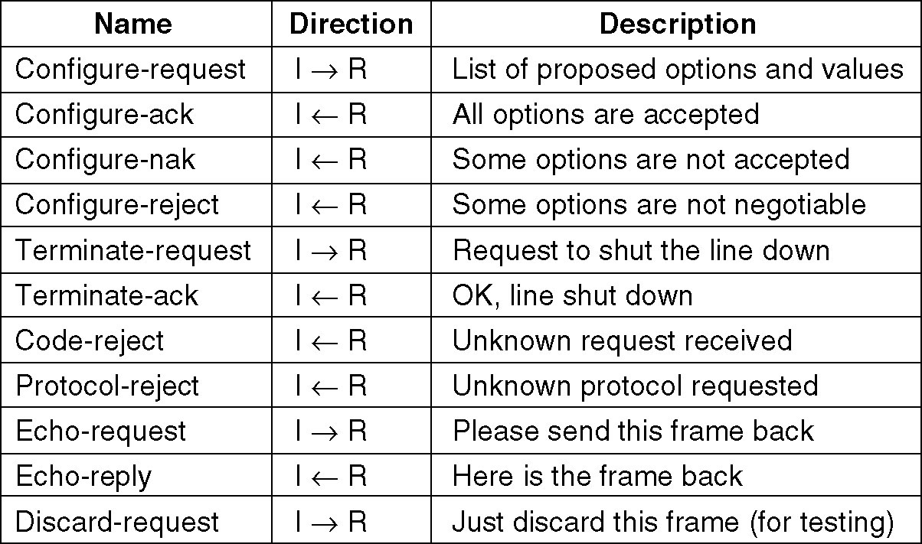
PPP – Point to Point Protocol (3)
The LCP frame types.

Slide 177
END OF CHAPTER 3
PART - 1

